Slide 1
Local Government Budgets and Expenditure Review, 2011
Strengthening governance to improve service delivery
National Treasury, 14 September 2011

Slide 2
Why a Local Government Budgets and Expenditure Review?
Review measures progress in local government
Allows progress over the last three years to be measured
Review shows where municipalities have allocated and spent public money
Are municipal budgets allocating funds in line with development priorities?
Review explores developmental role of municipalities
Does government need to adopt a more differentiated approach to enable rural and urban municipalities to be more effective?
Are policies delivering the intended outcomes?
Are municipalities delivering services to all?
Are budgets buying the planned outputs?
Review shows link between policies, budgets, expenditures and outputs

Slide 3
Data issues
www.treasury.gov.za/publications/igfr/2011/default.aspx
Detailed budget and expenditure data published on National Treasury’s website
Every effort made to ensure reliability of budget and expenditure information
The implementation of the Municipal Budget And Reporting Regulations
Factors that impact on the comparability of information over the period
Compliance with the MFMA requirement relating to consolidated budgets and financial statements
Audited financial statements for 2006/07 to 2008/09
Available audited financial statements and pre-audit information for 2009/10
Budget and related documents for 2010/11 to 2012/13
The following sources were used:
Replacement of the RSC levy for metros has an impact on the local government equitable share

Slide 4
Outline of presentation
Key findings of the review
Summary of chapters
Conclusion

Slide 5
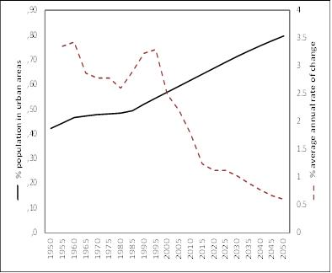
Local government faces ongoing challenges
Demographic pressures arising from urbanisation
Crisis in credibility
Economic pressures arising from economic growth
Percentage of population in urban areas and growth in urban population
Gross value added per capita by type of municipality, 2009
Trust in government institutions, 2004 to 2009

Slide 6
There is considerable pressure for infrastructure investment and improved service delivery
Proxies of poverty by municipal location, 2007
Households without access to basic services, 2007
To combat poverty
To support growth
Nominal value of building plans passed and completed vs local government capital expenditure, 1998 – 2009

Slide 7
National government continues to provide significant support to local government
Massive real growth in national transfers
Significant policy reforms
Municipal Budget and Reporting Regulations
Targeted capacity and systems support
Support in planning and budget reform
Three-year allocations and payment schedules for national and provincial transfers (DoR Act)
Improved in-year financial monitoring
R3bn spent on Siyenza Manje between 2007 and 2010 to provide hands-on support to municipalities
Additional support through conditional grants
Transfers by type, 2006/07 - 2012/13

Slide 8
… and municipal challenges remain …
Policies and plans
Performance
Limited focus on economic development
Outdated spatial plans
Delays in approving development plans
Prevalence of non-priority spending
Poor quality IDPs
Unfunded budgets
Inadequate spending on repairs and maintenance
Underspending of capital budgets
Deteriorating levels of service
Procedures
Poor revenue management
Badly managed procurement processes
Poor asset management processes
Priorities

Slide 9
The 2011 LGBER offers both new and updated analysis of key issues
Focuses on the adequacy of municipal initiatives
Providing basic services and supporting development
Strengthening governance and the stewardship of resources
Structured in four parts
Social and economic context for local governance
Financing and management issues: trends, MFMA implementation, leveraging private finance and municipal personnel management
Service delivery: water and sanitation, electricity, roads and solid waste services
Supporting economic growth
Service delivery contexts: delivering services in rural areas, and managing cities

Slide 10
Key issues identified…
Quality of governance is critical to performance
Maintenance of existing assets needs urgent attention
Reconceptualise approach to combat poverty
Increased grant reliance, and reduced own funding of the capital budget
Lack of key technical skills – qualified managers, engineers and technicians
Own funding of capital budgets needs to increase
New housing developments are located on the periphery far from economic opportunities and services
Municipal budgets must be funded and realistic
Operating expenditures are too high – driven by non-priority spending
General under-pricing of municipal services – bankrupting municipalities
Capital budgets are too ambitious
Depleted cash reserves – operating at the absolute margin
Spending on repairs and maintenance inadequate to maintain assets
Weak asset management systems
Tariffs and operating budgets not making provision to fund capital
Municipalities (other than metros) not adequately leveraging private finance to fund economic infrastructure
Municipalities are not using labour intensive approaches to deliver services
Current modes of service delivery are too expensive and unsustainable, especially for poor households in rural areas
Governance challenges undermines service delivery
More competent senior mangers needed
Instability in senior management detracts from continuity
Revenue projections are unrealistic – not based on requirements of the MFMA
Maintenance spending is reactive, and so is more costly than planned maintenance

Slide 11
Potential policy responses include …
Creating fiscal space
Get back to basics in all aspects of revenue management and cash management
Focussing on sustainable human settlements
Ensuring fiscally sustainable choices in service delivery
Focus on leadership
Adopting a differentiated approach towards municipalities
Increase funding for repairs and maintenance
Appoint competent MMs, CFOs and senior managers
Effective development control to ensure poor households are located close to economic opportunities
Make more innovative use of opportunities to leverage private finance
Use labour intensive service delivery methods
Bring mayors and councils into the Outcomes monitoring system
Highlight difference between political leadership and management roles
Ensure tariffs are cost-reflective – including maintenance and capital spending
Use spatial planning, development approval and location of bulk infrastructure to guide private investment decisions
Depoliticise senior management appointments
Ensure co-ordination of infrastructure and housing investments
Better coordination of financing with the allocation of powers and functions
Use appropriate service standards and technologies, especially in rural areas
Ensure indigents policy is appropriately structured and properly implemented
Eliminate non-priority spending
Ensure value-for-money in procurement and contract management
Structuring the local government fiscal framework around municipalities’ fiscal capacity, to ensure more equitable funding of rural municipalities
Targeting support to municipalities where assistance is needed and there is a willingness to co-operate
Devolving of functions to municipalities with management capacity, especially housing and transport

Slide 12
Outline of presentation
Key findings of the review
Summary of chapters
Conclusion

Slide 13
Summary of chapters
Introduction and context
1. Introduction
2. Socio-economic and fiscal context of local government
Financial issues
4. Revenue and expenditure trends in local government
5. Financial management and MFMA implementation
Service delivery
8. Water and sanitation
9. Electricity
10. Roads
Delivery contexts of rural and city municipalities
12. Delivering municipal services in rural areas
13. Cities and the management of the built environment
3. Intergovernmental relations and the local government fiscal framework
6. Leveraging private finance
7. Managing municipal personnel
11. Solid waste services

Slide 14
There are significant differences between municipalities
Demographic trends
Economic profiles
Average household size by type of municipality, 2001 and 2007
The Census in October 2011 is critical to updating this information
Share of economic sector by type of municipality, 2009
Chapter 2 Socio-economic and fiscal context of local government

Slide 15
This requires municipalities to respond differently to their specific contexts
Combating poverty
Supporting economic growth
Proxies of poverty by type of municipality, 2007
All municipalities need to be aware of the poverty and unemployment within their jurisdictions, so they develop appropriate service delivery strategies, indigent policies and revenue strategies.
Growth by economic sector, 2006 and 2009
Municipalities need to be aware of how the sectors of the economy represented within their areas are performing – and then tailor their spatial plans and IDPs to provide appropriate support
Chapter 2 Socio-economic and fiscal context of local government

Slide 16
… while also responding to the opportunities created by national fiscal policy
Growth in transfers to local government
Stable macro-economic policy
Insulating LG from the effects of the recession
Stable and transparent transfers to LG
Prudent fiscal stance provides room for increased borrowing by municipalities
Public investments
Expanded public investment in infrastructure places pressure on municipal development planning and approval processes
Transfers to local government, 2006/07 – 2012/13
Transfers to LG grow by 10.4% between 2010/11 and 2013/14, compared to 7.6% for total government spending
Chapter 2 Socio-economic and fiscal context of local government

Slide 17
…and learning to do things better
Lessons from the World Cup
Success depends on hiring the best
Crisis in credibility
Getting governance right
Commit to acting ethically and in the best interests of the municipality
Put operating policies and procedures in place
Use ‘anchor management tools’ to drive delivery
Forward thinking in risk management of projects
Detailed cash management and payment transparency
Understand and respect the council/management division of responsibilities
Make appointments on the basis of competency
Councils must fulfill their oversight function
Service delivery protests, 2004 to 2010
Disputes with ratepayers in 42 towns – paying funds into trust accounts
Chapter 2 Socio-economic and fiscal context of local government

Slide 18
Local government has very specific service delivery responsibilities
Objects of local government
to provide democratic and accountable government for local communities
Developmental duties of municipalities
Section 153 of the Constitution
Priority functions of municipalities
to ensure the provision of services to communities in a sustainable manner
to promote social and economic development
to promote a safe and healthy environment
to encourage the involvement of communities and community organisations in the matters of local government
Section 152 of the Constitution
Structure and manage its administration and budgeting and planning processes to give priority to the basic needs of the community, and to promote the social and economic development of the community, and
Participate in national and provincial development programmes
A municipality must -
Water (potable)
Electricity reticulation
Sanitation
Refuse removal
Cemeteries
Fire fighting
Municipal health services
Municipal planning
Municipal roads
Storm water
Traffic and parking
Building regulations
Municipal public transport
Chapter 3 Intergovernmental relations and the local government fiscal framework

Slide 19
That the WHOLE local government fiscal framework is designed to finance municipalities
Transfers and Grants
Municipal own revenues
Direct transfers
Operating revenues
Equitable share & RSC levy replacement grant
Rates and taxes
Municipal operating budget
National / provincial operating grants
Service charges
Sources of capital funding
National / provincial infrastructure grants
Surplus / cash-backed reserves
Municipal borrowing
Indirect transfers
Municipal capital budget
Chapter 3 Intergovernmental relations and the local government fiscal framework

Slide 20
At the heart of local government is managing finances to deliver services

Slide 21
Summary of chapters
Introduction and context
1. Introduction
2. Socio-economic and fiscal context of local government
Financial issues
4. Revenue and expenditure trends in local government
5. Financial management and MFMA implementation
Service delivery
8. Water and sanitation
9. Electricity
10. Roads
Delivery contexts of rural and city municipalities
12. Delivering municipal services in rural areas
13. Cities and the management of the built environment
3. Intergovernmental relations and the local government fiscal framework
6. Leveraging private finance
7. Managing municipal personnel
11. Solid waste services

Slide 22
Municipalities are important economic actors
Contribution to GDP
LG expenditure averages about 6.9% of GDP
Approximately 80% of GDP generated in the 27 largest cities
Contribution to infrastructure investment
LG responsible for 15.9% of total public sector infrastructure expenditure
LG infrastructure and services are essential inputs to the rest of the economy
Share is declining due to more rapid growth in capital expenditures by provinces and public enterprises
Chapter 4 Revenue and expenditure trends in local government

Slide 23
They manage a significant portion of the public budget
Municipal own revenues are key to service delivery
The revenue –service link between customers and municipalities is an important dimension of democratic local accountability
National transfers recognise differences in fiscal capacity and support the extending access to basic services
Significant variation between municipalities
levels of revenue effort and capacity to spend
Reflects variations in:
Significant component of total public expenditures
20.0% of total government spending in 2009/10
R176.3 billion in operating revenues, mainly from service charges, property rates and grants
R37.5 billion in capital expenditure, funded mainly by grants
Average annual per capita spending of R4208 in 2009/10, but varies from R6609 in Gauteng to R1993 in Limpopo
provision of services, no. of business customers and income levels
maturity, given history of local government in region
Revenues from service charges pay for bulk electricity and water
Chapter 4 Revenue and expenditure trends in local government

Slide 24
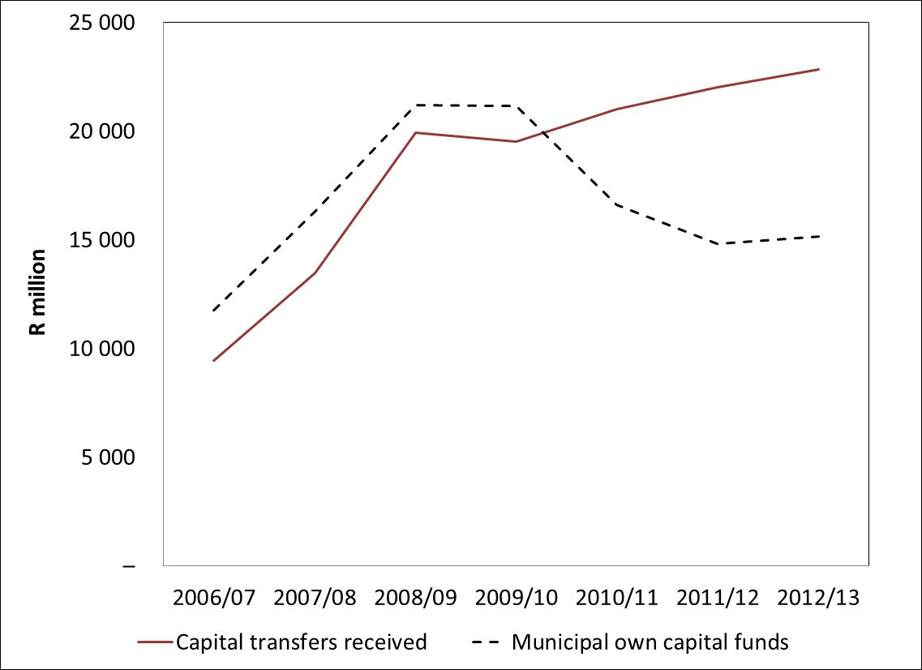
Municipalities continue to face important fiscal challenges
Municipal own contribution to capital expenditure, 2006 to 2012
Under-pricing of services
Municipalities not following the Systems Act principles for tariff setting
Municipal own contribution to capital spending
Inadequate spending on repairs and maintenance
Cutting spending on maintenance is not seen as politically sensitive, but will have a disastrous impact on the reliability of services
High outstanding consumer debts
In December 2010, municipalities were owed a total of R62.3 billion. This represents an increase of 10.8% from the same month in 2009
Pay attention to revenue management
Get the basics right to ensure revenue value-chain is complete
Integrity of billing information, accuracy of billing systems and ability to collect
On average, tariffs must reflect the cost of rendering the service
Municipal own contributions are now less than 50% of total capital spending
Chapter 4 Revenue and expenditure trends in local government

Slide 25
MFMA aims to ensure alignment in the municipal accountability cycle
Planned future reforms
Standard chart of accounts of local government
Strengthening revenue and cash management
Structure of the Service Delivery and Budget Implementation Plan
Strengthen reporting on non-financial information
Regulations on financial misconduct to facilitate enforcement
Recent financial management reforms
Municipal Budget and Reporting Regulations
Strengthening in-year reporting
Return of unspent conditional grants to the national revenue fund in line with DoRA
Chapter 5 Financial management and MFMA implementation

Slide 26
Management is improving in response to financial management reform programme
Reforms essential for accountability
Improved budgeting
Improved reporting
In-year reporting coverage has improved and all municipalities now report on a routine basis
Annual financial statements are submitted by most municipalities
More municipalities need to produce annual reports
Improving audit outcomes, off a low base
Audit opinions for all municipalities, 2006/07-2009/10
More timely budget preparation
Municipalities that tabled and approved budgets on time, 2005/06-2010/11
Chapter 5 Financial management and MFMA implementation

Slide 27
Concerns with the quality of budgeting…
Need to strengthen capacity
Municipalities need to prepare for implementation of the Competency Regulations
Many municipal budgets are not funded
Internship programme – 1241 interns have been through the programme since 2004
National Treasury is now responsible for the deployment of hands-on financial support to municipalities
Funding compliance of municipalities’ approved 2010/11 budgets
Only 123 municipalities had budgets that were adequately funded
Chapter 5 Financial management and MFMA implementation

Slide 28
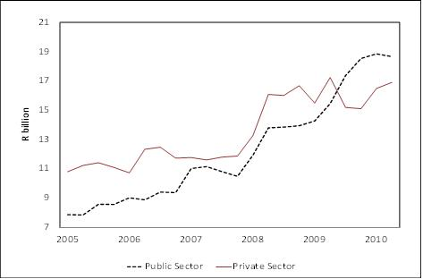
Scope exists to improve access to private finance
Demand for capital infrastructure remains high
Lending dominated by the DBSA
Scope exists for further growth in private capital funding
National transfers are the major source of finance for municipal capital budgets – they provided 51% of capital funding in 2010/11
External loans contributed 20.7% as a funding source in 2010/11. This is down from 24.9% in 2006/07.
Rehabilitating existing infrastructure is a priority
Municipal infrastructure investment requirement, 2009
INCA (a major private lender) has withdrawn from the municipal market
Trends in the municipal borrowing market
Chapter 6 Leveraging private finance

Slide 29
Various sources of private finance are available
Municipal borrowing
Municipal borrowing increased from R18.7bn to R38.1bn between 2005 and 2010 (growth of 15% per annum)
Land based financing strategies
Development charges
Costs of new infrastructure are paid by the property owners benefiting from such developments
Municipal bonds issued by Johannesburg, Cape Town and Ekurhuleni come to R11.8bn
Facilitates more rapid development, and a better application of scarce capital funding
Aim to use municipal land to facilitate realisation of the municipality’s spatial development framework
Alternatives – security for loans, leaseholds, land-use exchanges and land swaps
Good stewardship = using the proceeds from selling municipal land to buy other land
Using the proceeds from land sales to finance infrastructure replaces an appreciating asset with a depreciating asset
Public Private Partnerships
A model for risk sharing between a municipality and its private sector partners
Private partners raise debt and equity to finance the project
Chapter 6 Leveraging private finance

Slide 30
Scope exists to further develop private finance opportunities
Clear regulatory framework in place
National government does not stand surety
Dealing with constraints
National and provincial government may not lend to municipalities
Municipalities may offer lenders a range of credit enhancements
Term of borrowing may not exceed the useful life of the assets being financed
Forward planning of capital budgets is generally poor, resulting in underspending
DBSA needs to find ways of crowding in private finance, rather than competing with private lenders
Explore creating a pooled finance vehicle for secondary cities
Growth in conditional grants to fund capital are reducing municipalities’ incentive to explore alternative financing mechanisms for infrastructure
Need to develop the capacity of the treasury function
Municipalities are encouraged to get credit ratings
Chapter 6 Leveraging private finance

Slide 31
Staff are a major municipal asset
Significant number of employees
Over 278 000 jobs, or 2.1% of total SA employment (2009)
Accounts for between 25 and 30% of operating expenditures
Expenditures growing faster than jobs
Employment grew by 4% or 10 700 employees between 2006 and 2009
Vacancies rose from 21.9% to 23.2% between 2006 and 2008, mainly due to municipalities revising their organisational structures
Cost per employee rising
(mostly slower than wage increases)
Personnel expenditure increases from R30bn in 2006/07 to R46.7bn in 2009/10 (growth of 52.5%)
Average cost per employee, 2006 and 2009
Wage agreements from 2006 to 2009 provide for a cumulative basic increase of 35.73%
Chapter 7 Managing Municipal Personnel

Slide 32
Personnel policies require careful management
Getting the personnel mix right
Filling key positions
Percentage of positions vacant in key sectors, 2009
Vacant posts for section 57 managers, 2006 and 2009
Chapter 7 Managing Municipal Personnel

Slide 33
Value for money from personnel spending depends on better performance management
Legal framework for performance management
Municipal Systems Act requires each municipality to have in place a performance management system
Dealing with poor performance
Poor performance is indicative of poor governance
Municipal managers and s57 managers must have performance agreements linked to the IDP and budget
Performance agreements of MMs and s57 managers must be made public (published on official website)
Do officials in critical positions have the required competencies?
Is performance being properly evaluated?
22% of MMs did not have performance agreements in 2009
Are municipalities implementing the Municipal Regulations on Minimum Competency Levels?
Chapter 7 Managing Municipal Personnel

Slide 34
Summary of chapters
Introduction and context
1. Introduction
2. Socio-economic and fiscal context of local government
Financial issues
4. Revenue and expenditure trends in local government
5. Financial management and MFMA implementation
Service delivery
8. Water and sanitation
9. Electricity
10. Roads
Delivery contexts of rural and city municipalities
12. Delivering municipal services in rural areas
13. Cities and the management of the built environment
3. Intergovernmental relations and the local government fiscal framework
6. Leveraging private finance
7. Managing municipal personnel
11. Solid waste services

Slide 35
Water services have seen significant growth in access and expenditures
Municipal water expenditure increases from R8.4bn in 06/07 to R35.8bn in 12/13
Between 2009/10 and 2012/13, operational expenditure increases at 35% p.a
Capital expenditure grew by 114% p.a. between 2006/07 and 2009/10 – from a low base
Municipal sanitation expenditure increases from R3.3bn in 06/07 to R15.4bn in 12/13
Between 2009/10 and 2012/13, operational expenditure increases at 32% p.a
Access to basic water and sanitation services improved
Access to basic water increased by 7% or 695 000 btwn 2008 and 2009
Access to basic sanitation increased by 7.6% or 657 000 btwn 2008 and 2009
Provision of Free Basic Services is being better targeted
Municipalities budgeted to spend R23.5bn on water service infrastructure between 2010/11 and 2012/13
Capital expenditure grew by 36% p.a. between 2009/10 and 2012/13
Municipalities budgeted to spend R15bn on sanitation infrastructure between 2010/11 and 2012/13
Households receiving free basic water and sanitation
Chapter 8 Water and Sanitation

Slide 36
… but sector faces important challenges
Water resources - concerns with quality and availability
South Africa is a water scarce country
Issues in the water and sanitation functions
Division of country into catchment-based water management areas to facilitate better management of water resources
Only 26 municipalities tap water given ‘Blue drop status’ in 2009/10
75% of sewerage treatments plants not up to ‘Green drop status’ in 2009/10
Increase investment in renewal and maintenance of existing water infrastructure
Need to improve alignment of funding allocations to municipalities responsible for the actual delivery of the water and sanitation services
Need to clarify responsibilities between local and district municipalities
Non-revenue water: 29.7% is lost and 5.9% is stolen
Need to ring-fence functions and ensure tariffs are cost-reflective
Chapter 8 Water and Sanitation

Slide 37
Similar trends are evident in electricity distribution
Household access to electricity improved
340 000 more households had access to electricity in 2009 than 2008
Expenditure increased from R15bn in 06/07 to R59bn in 12/13
Operating revenue grows at above 20% per year in line with increases in the bulk price of electricity
Budgeted capital expenditure on electricity increases from R4.7bn in 2009/10 to R5.7bn in 2011/12, before declining to R4.9bn in 2012/13
6.2% more households received free basic electricity in 2009 than 2008
Expenditure grew at 26.7% per year between 2006/07 and 2009/10
Compared to 2010/11, municipalities’ budgeted capital investment in electricity declines by 14% in 2011/12 and again by 7% in 2012/13
Consumer units access to electricity and free basic electricity
Chapter 9 Electricity

Slide 38
…. but challenges are not confined to electricity generation
Generation challenges
The government’s electricity generation build programme will add 14000 MW by 2020
Demand side management and electricity conservation programmes are expected to save 3420 MW per year by 2017
Distribution challenges
Government has decided not to create REDs, but there is still a need to address: poor infrastructure maintenance and weak management capacity
Increased investment in new and existing electricity infrastructure
Addressing non-technical electricity losses: international norm is 3.5%
The process of increasing the cost of bulk electricity to the long run cost of supplying electricity is placing strain on both customers and municipal finances
Pricing challenges
Increases in the bulk price of electricity mean electricity will be 4X higher in 2014 than at the start of 2009
Need to protect poor households from price increases, e.g. through use of inclining block tariffs
Eskom services 48.6% of domestic customers.
This means municipalities loose this source of own revenue, and cannot use electricity cut-offs for credit control
Municipalities need to ring-fence the finances of electricity departments
Price of electricity needs to increase to the level of the cost of new generation, so as to finance Eskom’s investments and facilitate IPP entrants into sector
Chapter 9 Electricity

Slide 39
Municipal roads are coming under increasing pressure
State of public roads managed by provinces and municipalities
Challenges faced by municipalities
Focus on new infrastructure at the expense of maintenance
Maintenance is regarded to be a discretionary expenditure
Poor integration of housing and transport developments
Poor co-ordination of road excavations
Loss of key technical staff
Lack of asset lifecycle planning
Co-ordination and strengthening of public transport
State of paved and gravel roads, 2010
Chapter 10 Roads

Slide 40
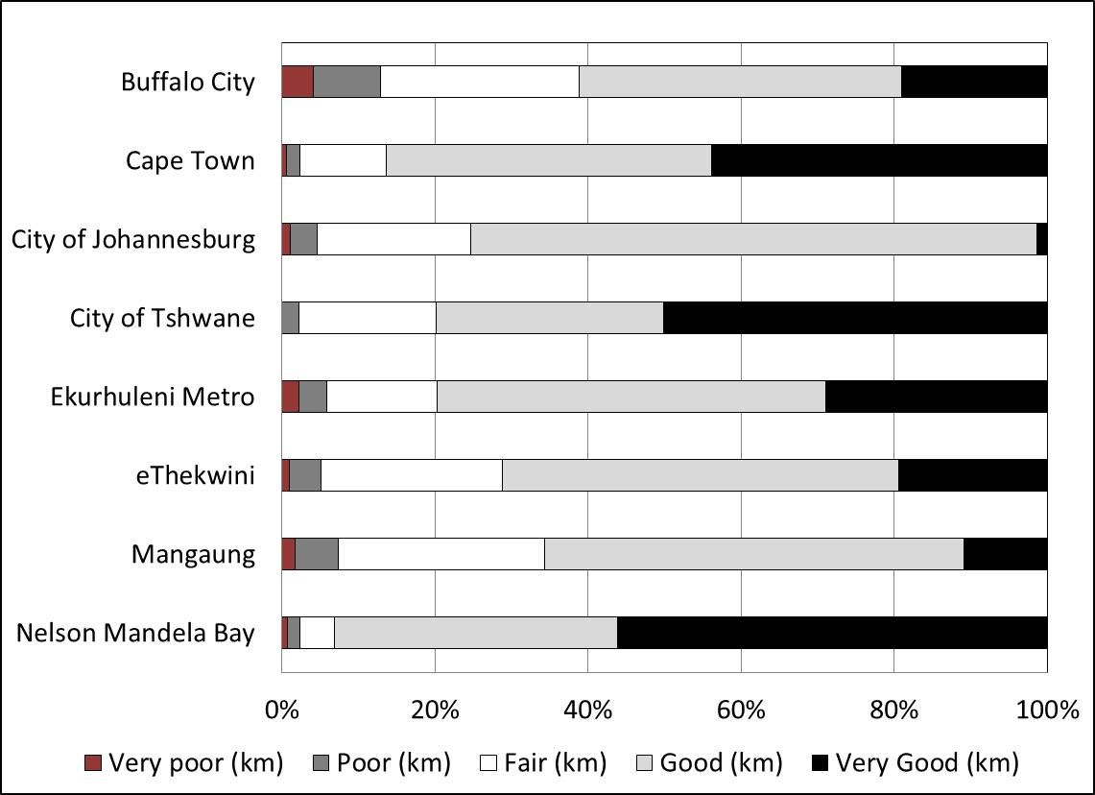
Investments in roads increased before the World Cup, but have not been sustained
Metros capital expenditure on roads
State of metro roads
Roads are essential for economic activity
Jo’burg has budgeted to spend R2.6bn over MTREF, which is less than NMB and Cape Town
Chapter 10 Roads

Slide 41
There is expanding access to solid waste services …
Expanding access to solid waste services
Expenditure is growing strongly
Operating expenditure has increased from R3.6bn in 2006/07 to R7.3bn in 2009/10
Capital spending has increased from R118m in 2006/07 to R951m in 2009/10
The increase in capital spending is over 100% per annum, but is still short of what is required
Required capital is very lumpy – making it difficult for municipalities to finance, e.g. new dump sites
Operating revenue is 43% less than expenditure in 2009/10 – need to address tariffs
Access to refuse removal services
1.7m more households getting refuse services
Chapter 11 Solid waste services

Slide 42
… but need to take advantage of opportunities in the sector
Waste stream is growing rapidly
Urbanisation is leading to increasing waste streams
Waste minimisation, recycling and energy recovery
95% of waste goes to land fills
Waste volumes grew by 79% per year since 2004 in Gauteng
Employment creation
10% of municipal workforce or 25 500 employees work in waste management (excludes staff for outsourced services)
Metros employ 1.5 staff per 1000 customers, compared to 6.5 in rural municipalities
Potentially labour intensive operations, but the tendency is towards capital intensive approaches to providing service
Estimates suggest waste volumes have increased from 42 million m³ to 68 million m³ between1997 and 2010
Only 2.2% of waste collected in Gauteng is recycled
Only 20% of household waste is recycled – most of it before collection
Need to look at:
Reducing consumer goods packaging
Developing waste management plans for priority waste streams (lighting, tyres, paper and packaging and veterinary products)
Sorting at source and recycling
Waste to energy schemes – landfill methane plants, and incineration
Chapter 11 Solid waste services

Slide 43
Summary of chapters
Introduction and context
1. Introduction
2. Socio-economic and fiscal context of local government
Financial issues
4. Revenue and expenditure trends in local government
5. Financial management and MFMA implementation
Service delivery
8. Water and sanitation
9. Electricity
10. Roads
Delivery contexts of rural and city municipalities
12. Delivering municipal services in rural areas
13. Cities and the management of the built environment
3. Intergovernmental relations and the local government fiscal framework
6. Leveraging private finance
7. Managing municipal personnel
11. Solid waste services

Slide 44
Rural municipalities face particular challenges…
Identifying rural municipalities
The classification system used by DCoG categorizes rural municipalities as:
Rural areas have very different characteristics
B3 - Small towns (111) – municipalities with one or more small towns and rural areas dominated by commercial farming
B4 – Mostly rural (70) – municipalities with one or two small towns, communal land tenure and villages or scattered groups of dwellings (typically located in the former homelands)
Human settlements characteristics:
B3 – 52% in towns, 29% farms, 10% tribal land
  B4 – 7% in towns, 7% farms, 83% tribal land
Share of GVA
Chapter 12 Delivering municipal services in rural areas

Slide 45
Which requires rural development efforts to be strengthened
Rural development strategy
Focuses on
Access to basic services is improving, but backlogs remain concentrated in rural areas
strengthening infrastructure
agrarian transformation and land reform
provision of basic services
Local Economic Development
LED needs to support rural people participate in the local economy
Provision of municipal infrastructure – particularly access roads
Ensuring a user-friendly regulatory environment that supports development and new investment
Work with other institutions in catalytic partnerships – departments, private sectors, intermediaries and communities
Distribution of service delivery backlogs, 2007
Extending and sustaining access to basic services:
Agree with communities on the use of appropriate technologies
Innovation in the deployment of appropriate technologies
Addressing technical skills and leveraging local capacity
Chapter 12 Delivering municipal services in rural areas

Slide 46
And appropriate financing for rural municipalities
Equitable share and grants
Scope to improve fiscal effort, even though fiscal capacity its limited
Own revenue challenges
Many rural municipalities (B4) do not charge non-poor households property rates and service charges
Problems with the allocation of functions and ensuring funds reach the municipality responsible for actual service delivery
Property rates regime faces challenges in traditional land tenure areas due to:
Unclear powers between government and traditional leaders
A weak social contract between the municipality and communities
A poor understanding of value-based property taxes
Equitable share finances the provision of basic services and institutional capacity, while conditional grants address infrastructure for service delivery
Grant dependence of rural municipalities is high, due to limited fiscal capacity
GVA vs municipal own revenue, 2008/09
Small town municipalities
8.9% of GVA
6.8% of own revenue
Mostly rural municipalities
5.6% of GVA
1.9% of own revenue
Chapter 12 Delivering municipal services in rural areas

Slide 47
Cities face particular challenges…
Urbanisation trends
Driven by both rural-urban migration and organic growth
By 2030, an estimated 71% of South Africans will live in cities
This is an increase of 7.8 million people compared to 2007
Concentration of economic activity
80% of economic activity occurs in the country’s 27 largest cities
Economic growth is more rapid in cities, than the national average
Apartheid spatial patterns persist
Chapter 13 Cities and the management of the built environment

Slide 48
Which expenditure on the built environment seeks to address
Human settlements
Public transport
Public transport subsidies in 2008/09 were R6.8bn
In 2009/10 cities spent:
R2.4bn on integrated rapid public transport networks
R1.9bn on the public transport infrastructure and systems grant
Challenges include:
Trips distances are three times those in denser cities
Bus services are loosing market share to minibuses reducing efficiency
Industry not responsive to off-peak travel needs
Safety and security concerns of public transport remain
Expenditure on housing and housing delivery, 2005-2009
Lack of certainty in funding limits cities’ ability to plan and co-ordinate development
In 2009/10:
Metros - R1.2bn
Secondary cities – R250m
Chapter 13 Cities and the management of the built environment

Slide 49
And which is also being addressed through policy
Spatial planning and land use management
Devolution of housing and transport functions
Municipalities are the logical authority to plan and provide human settlement development
Strengthening own revenue potential and effort
Cities have significant, but under-uitilised own revenue potential
The Development Facilitation Act has been declared unconstitutional
Constitutional court confirmed that re-zoning of land and the establishment of townships are exclusive municipal functions
Review of land use management legislation is underway
Accreditation of municipalities to deliver the housing function needs to be fast-tracked
Devolution of public transport function to cities will allow for better planning and integration with human settlements
Both require the fiscal framework to respond to changes in responsibilities for the functions
Need to improve revenue management
Explore additional avenues to raise revenues, e.g. development charges
Re-evaluate the approach to free basic services and the range of free services
Chapter 13 Cities and the management of the built environment

Slide 50
Outline of presentation
Key findings of the review
Summary of chapters
Conclusion

Slide 51
Uses of this Review
Contains extensive data and analysis
Treasury has dramatically increased the availability of raw data on municipal finances
Treasury welcomes alternative and / or additional analysis of issues
Provides a starting point for legislative oversight
Range of data provided on national programmes and municipal performance
Aggregate and average figures should be compared with individual municipal performances
National and local policy needs to respond
Significant policy challenges ahead, in almost all sectors, at both municipal and national level
Analysis and debate must deepen to ensure effective response

Slide 52
Thank you

